Slide 1
Sprint 4 – Team 4 Text Mining Analysis & power bi
Ahmed Ashraf Sadek, Amanda Long, Zawaad Shah

Slide 2
Sprint Stories
Epic – Finalizing Analysis with BI
Update EmployeeReviews database
Create and add results table
Create sharepoint links results
Add files and links to results table
Create data visualizations using Pandas (Python)
Create 3 Key Insights using Python
Create WordClouds based on TextMining Results

Slide 3
Sprint stories - continued
Create data visualizations using Power BI
Create interactive map using Power BI
Create visualizations for key insights
Create a Text Classification Model using SciKit-Learn with SpaCy outputs
Create SpaCy pipeline components
Use Scikit-Learn to do a Train/Test Split
Train the model and test the results
Determine Key Business Questions to answer in the final report.
Determine at least 3 questions to present as output for our research

Slide 4
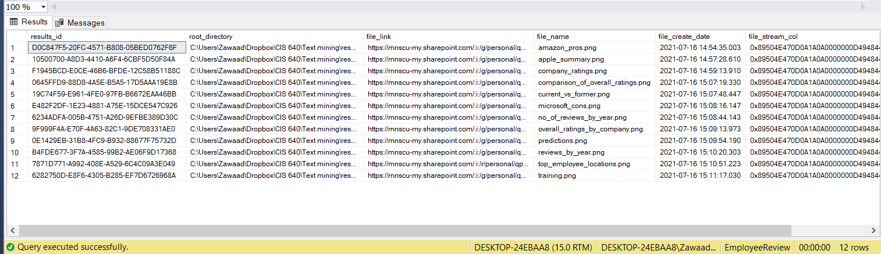
Update database with results table

Slide 5
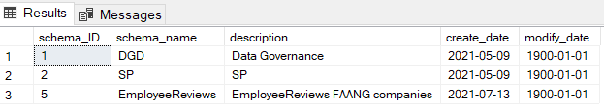
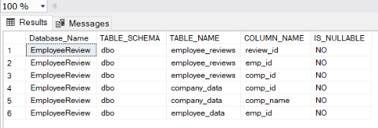
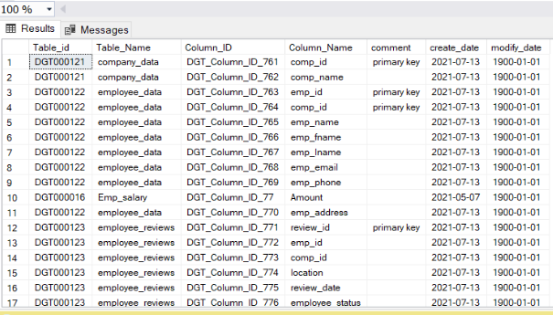
Data governance comparison
Columns, tables and schema

Slide 6
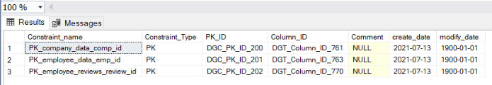
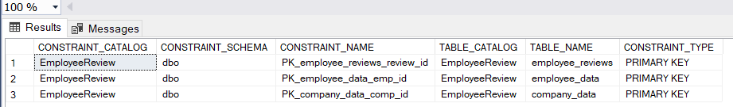
Primary keys

Slide 7
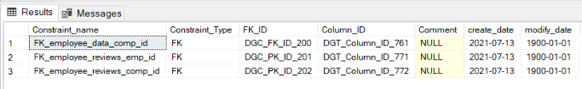
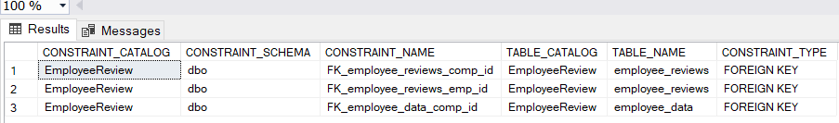
Foreign keys

Slide 8
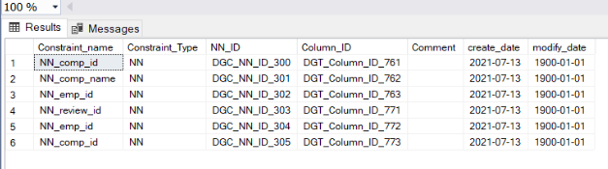
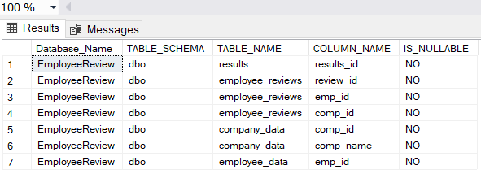
Not nulls

Slide 9
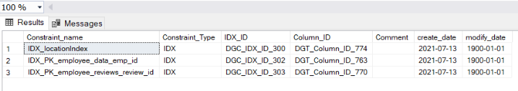
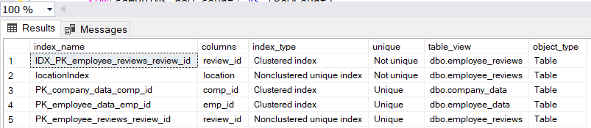
Indexes

Slide 10
Key Business Questions
What are the main drivers for pros/cons/advice/summary per company?
How are the average ratings by category for the companies?
Where are the biggest hubs (locations) of employees who left a review?
Can we build a text classification model to predict whether a review is positive or negative?
Are there any other trends in the data that we can discover?

Slide 11
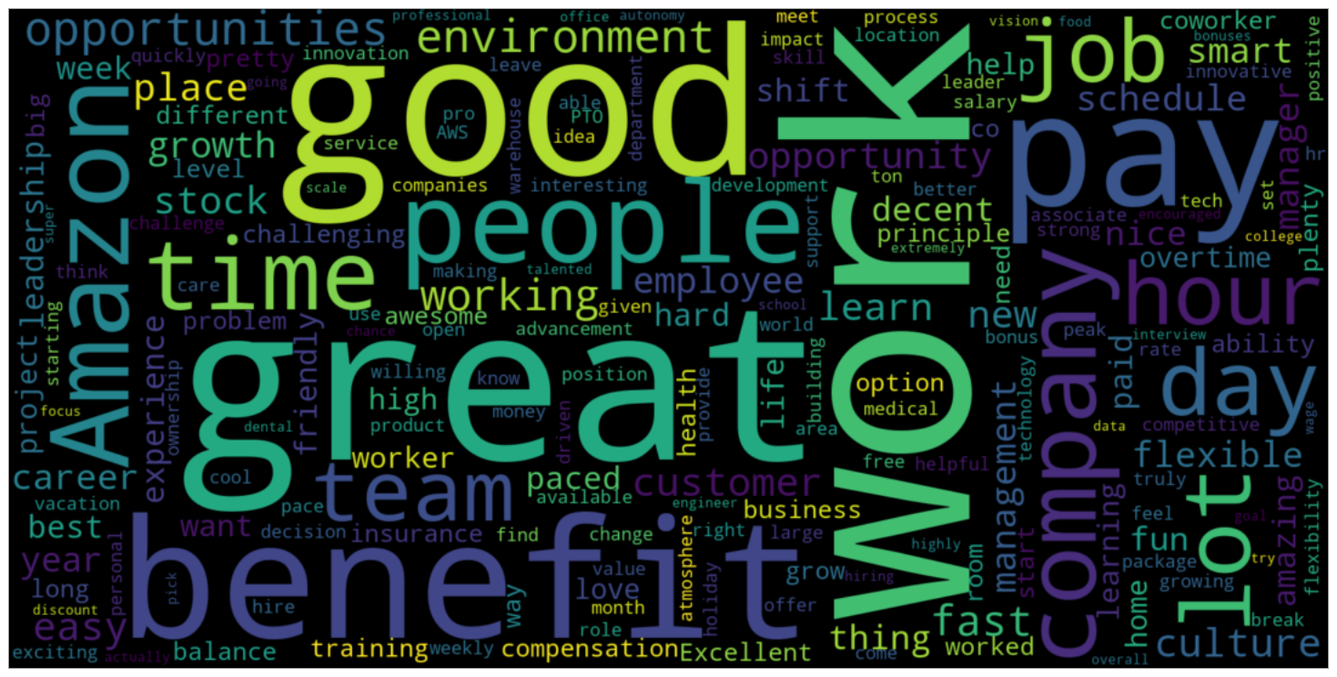
Data visualizations
Amazon pros

Slide 12
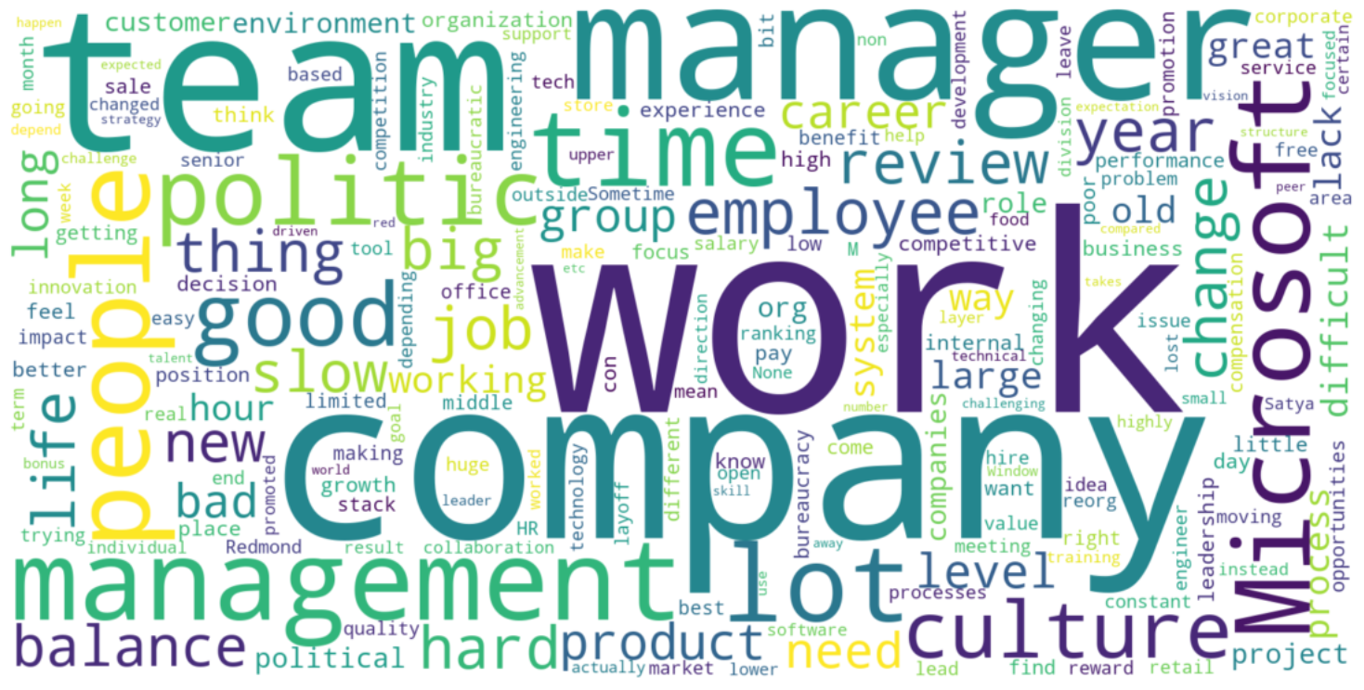
Microsoft cons

Slide 13
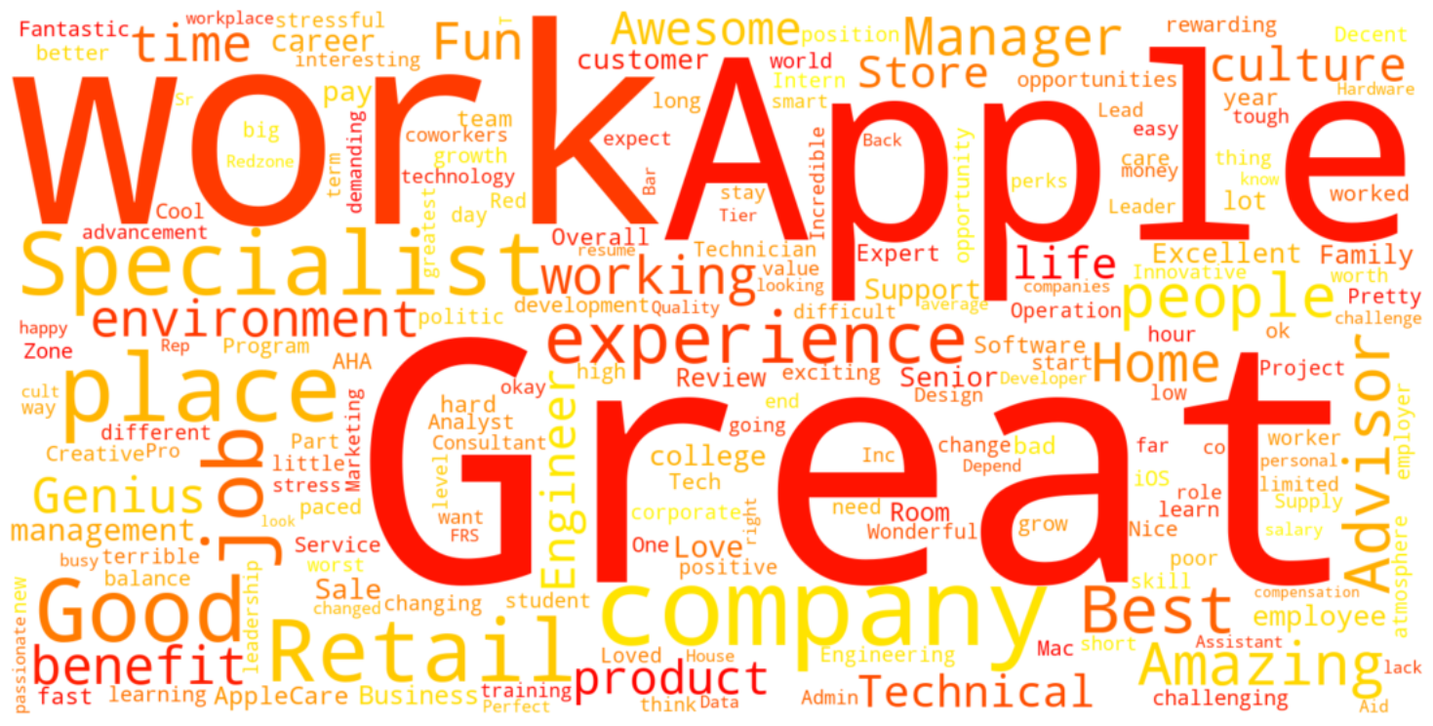
Apple summary

Slide 14
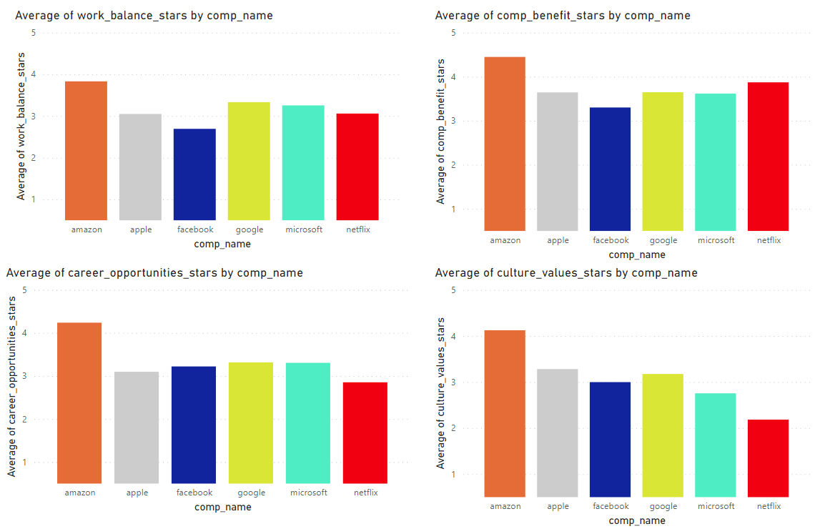
Comparison of different rating categories by company

Slide 15
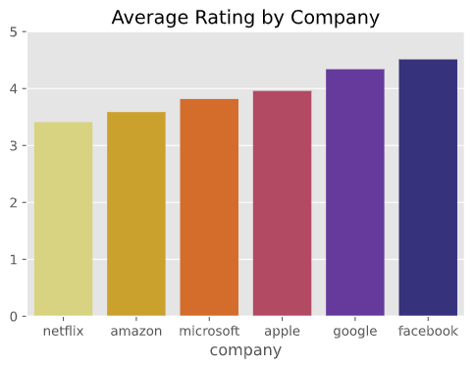
Company ratings

Slide 16
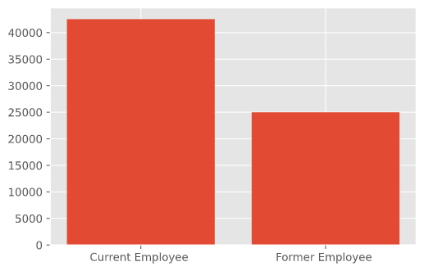
Count of Current vs Former Employee Reviews

Slide 17
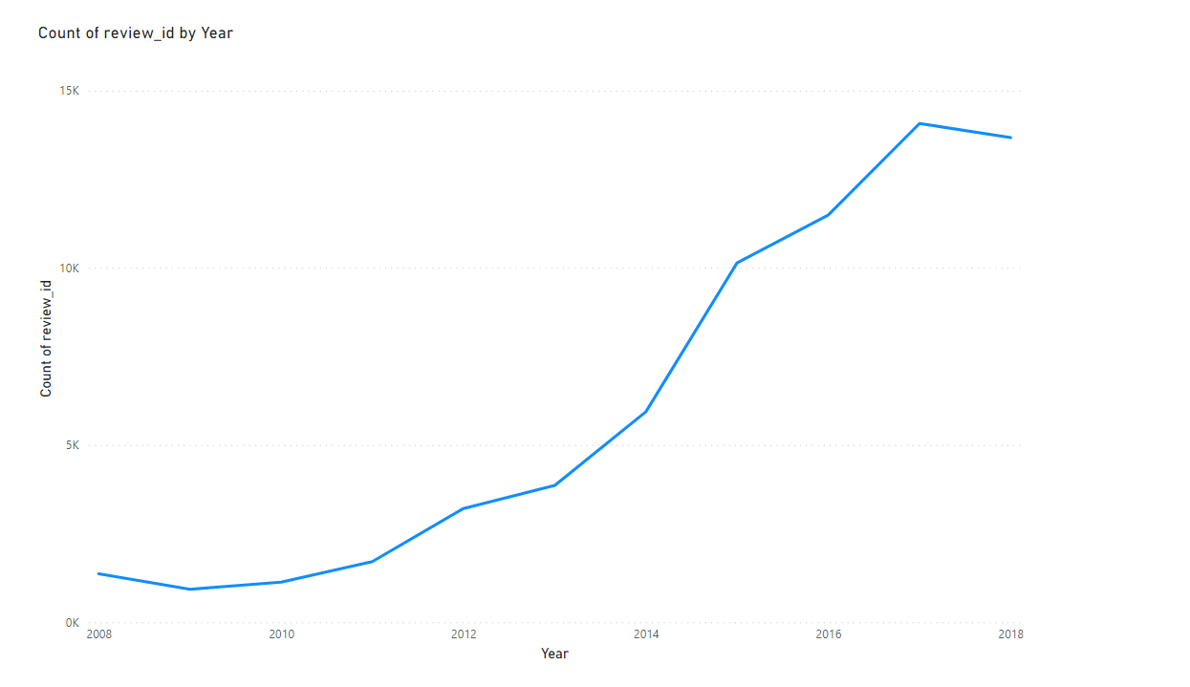
Power BI – Trend of Reviews by year

Slide 18
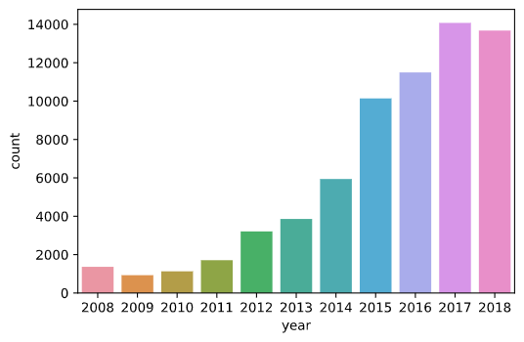
Number of Reviews by year

Slide 19
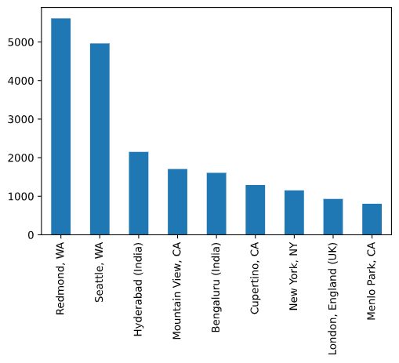
Top Review locations

Slide 20
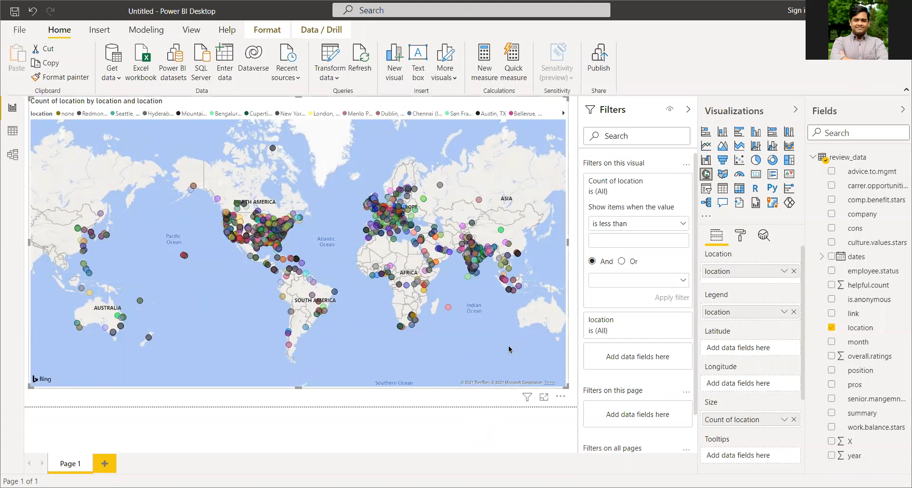
interactive map using Power BI

Slide 21
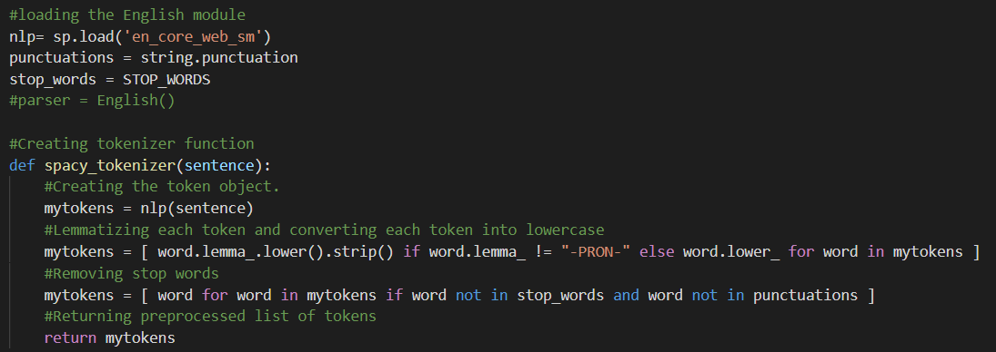
Creating a text classification model
Tokenizer Function

Slide 22
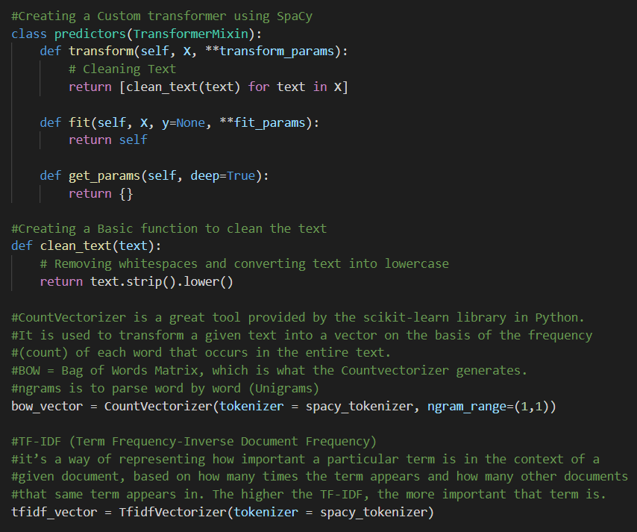
Bag of Words (BOW)
Term Frequency

Slide 23
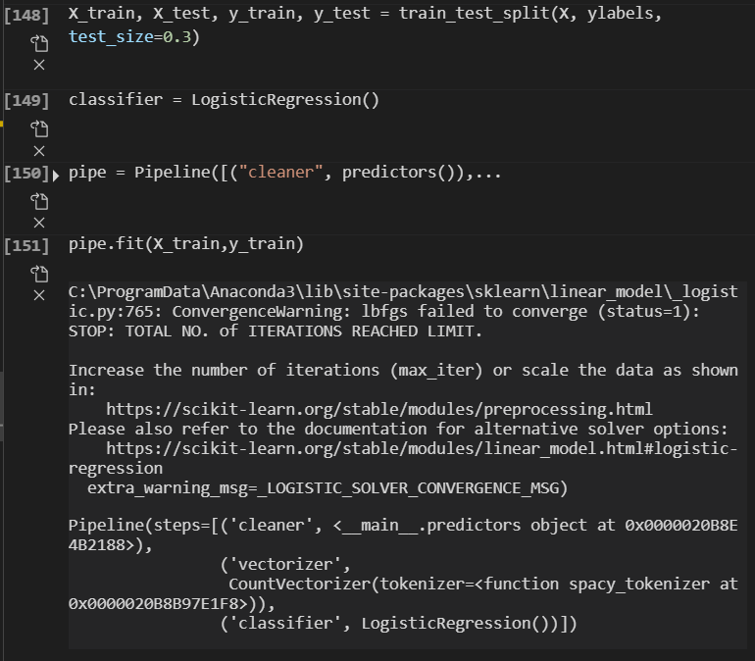
USING SCIKIT-LEARN TO DO A TRAIN/TEST SPLIT
Training

Slide 24
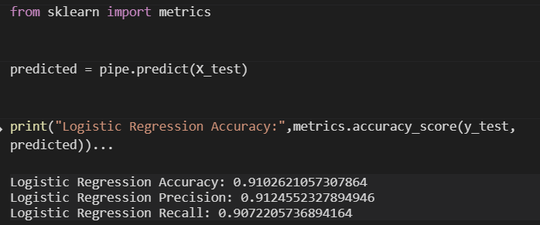
testing the results
Predictions

Slide 25
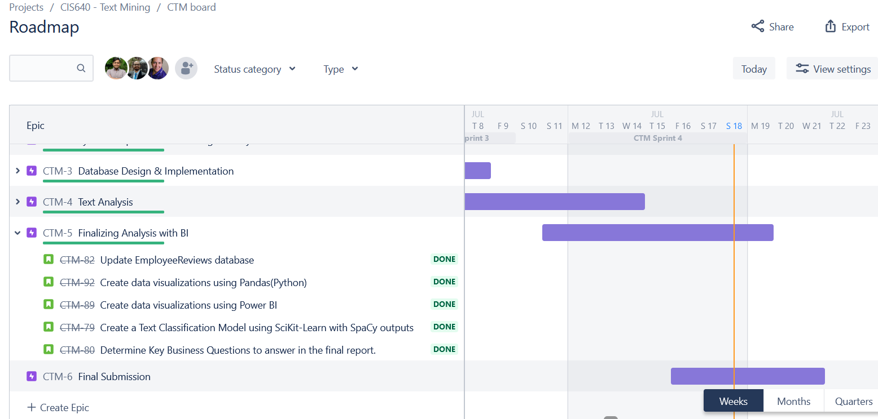
Sprint 4 – Done

Slide 26
Lessons Learned
Using Power BI and Python for visualizations.
Using FILESTREAM to save files in a SQL database.
Using SciKit-Learn to create a text classification model with Logistic Regression.
Opinions of employees working at FAANG companies.
What some of the best and worst things about working for each company are.

Slide 27
Thank you ☺

